Slide 1
vectorizer
Overview
Types of vectorizer
Example

Slide 2
overview
Text data requires special preparation before for the predictive modeling tasks
Must/may include
Sentence/word tokenization
Removal of stopwords (inclusive of domain stop words)
Stemming or lemmatizing
Lowercasing/capitalization
Short names, acronyms, Fixing misspelled words.
Duplicate words removal
Treatment to punctuations
Removal of URLs/@ etc
Treatment to emotion icons
Words need to be encoded as integers or floating point values for use as input to a machine learning algorithm, called feature extraction and/or vectorization.

Slide 3
Bag of words (bow)
Machine learning algorithms cannot work with raw text directly
the text must be converted into numbers. Specifically, vectors of numbers.
Also called feature encoding.
A bag-of-words model, or BoW for short, is a way of extracting features from text for use in modeling
It comprises 2 things:
A vocabulary of known words.
A count/binary/frequency/normalized values of the words in each document.
Any information about the order or structure of words in the document is discarded.
The BoW model can be as simple or complex
Complex : deciding how to design the vocabulary of known words (or tokens) and how to score the presence of known words.

Slide 4
Bow - creation
Step 1: Collect Data
It was the best of times,
it was the worst of times,
it was the age of wisdom,
it was the age of foolishness
Step 2: Design the Vocabulary - list of all of the words. The unique words here (ignoring case and punctuation) are: “it” “was” “the” “best” “of” “times” “worst” “age” “wisdom” “foolishness”
That is a vocabulary of 10 words from a corpus containing 24 words.
Step 3: Create document term matrix (vector) - The next step is to score the words in each document.
Each line is considered a ‘document’
1 2 3 4 | “It was the best of times” = [1, 1, 1, 1, 1, 1, 0, 0, 0, 0] "it was the worst of times" = [1, 1, 1, 0, 1, 1, 1, 0, 0, 0] "it was the age of wisdom" = [1, 1, 1, 0, 1, 0, 0, 1, 1, 0] "it was the age of foolishness" = [1, 1, 1, 0, 1, 0, 0, 1, 0, 1]
New documents may contain new words outside of the vocabulary, can still be encoded,
only the occurrence of known words are scored and unknown words are ignored.
Can scale to large vocabularies and larger documents

Slide 5
Managing the vocabulary
Vocabulary size increases, so does the vector representation of documents.
Each document may contain very few of the known words in the vocabulary.
Results in a vector with lots of zero scores, called a sparse vector or sparse representation.
Text cleaning techniques must be put in place before the vocabulary creation

Slide 6
N-grams
Vocabulary of grouped words
each word or token is called a “gram”
allows the bag-of-words to capture a little bit more meaning from the document.
N-gram is an N-token sequence of words:
a 2-gram (more commonly called a bigram) is a two-word sequence of words like “please turn”, “turn your”, or “your homework”,
a 3-gram (more commonly called a trigram) is a three-word sequence of words like “please turn your”, or “turn your homework
E.g., the bigrams in : “It was the best of times” are as follows:
“it was”
“was the”
“the best”
“best of”
“of times”
Often a simple bigram approach is better than a 1-gram bag-of-words model for tasks like documentation classification.

Slide 7
Scoring tokens
Binary scoring - the presence or absence of words. (0 or 1)
Counts - Count the number of times each word appears in a document.
Frequencies - Calculate the frequency that each word appears in a document out of all the words in the document.
TF-IDF

Slide 8
TF-IDF
High frequency words vs the rarer domain specific words
A problem with scoring word frequency is that highly frequent words start to dominate in the document (e.g. larger score), but may not contain as much “informational content” to the model as rarer but perhaps domain specific words.
Solution
a statistical measure used to evaluate how important a word is to a document in a collection or corpus
rescale the frequency of words by how often they appear in all documents, so that the scores for frequent words like “the” that are also frequent across all documents are penalized.
Called Term Frequency – Inverse Document Frequency, or TF-IDF

Slide 9
Tf-idf
Each word has its respective TF and IDF score.
Term Frequency (TF) : is a scoring of the frequency of the word in the current document.
Inverse Document Frequency (IDF) : is a scoring of how rare the word is across documents.
The product of the TF and IDF scores of a term is called the TF-IDF score of that word.
The scores have the effect of highlighting words that are distinct (contain useful information) in a given document.
Thus the idf of a rare term is high, whereas the idf of a frequent term is likely to be low.

Slide 10
Tf-idf - calculation
TF: Term Frequency | IDF: Inverse Document Frequency
Since every document is different in length, it is possible that a term would appear many more times in long documents than shorter ones. Thus, the term frequency is often divided by the document length (aka. the total number of terms in the document) as a way of normalization: | measures how important/rare a term is. certain terms, such as "is", "of", and "that", may appear a lot of times but have little importance. Thus we need to weigh down the frequent terms while scale up the rare ones, by computing the following:
TF(t) = (Number of times term t appears in a document) / (Total number of terms in the document). | IDF(t) = log_e(Total number of documents / Number of documents with term t in it).
Consider a document containing 100 words wherein the word cat appears 3 times.
TF(cat) = 3 / 100 = 0.03. Now, assume we have 10 million documents and the word cat appears in 1000 of these.
IDF log(10,000,000 / 1000) = 4. Thus, the TF-IDF weight is : 0.03 * 4 = 0.12.

Slide 11
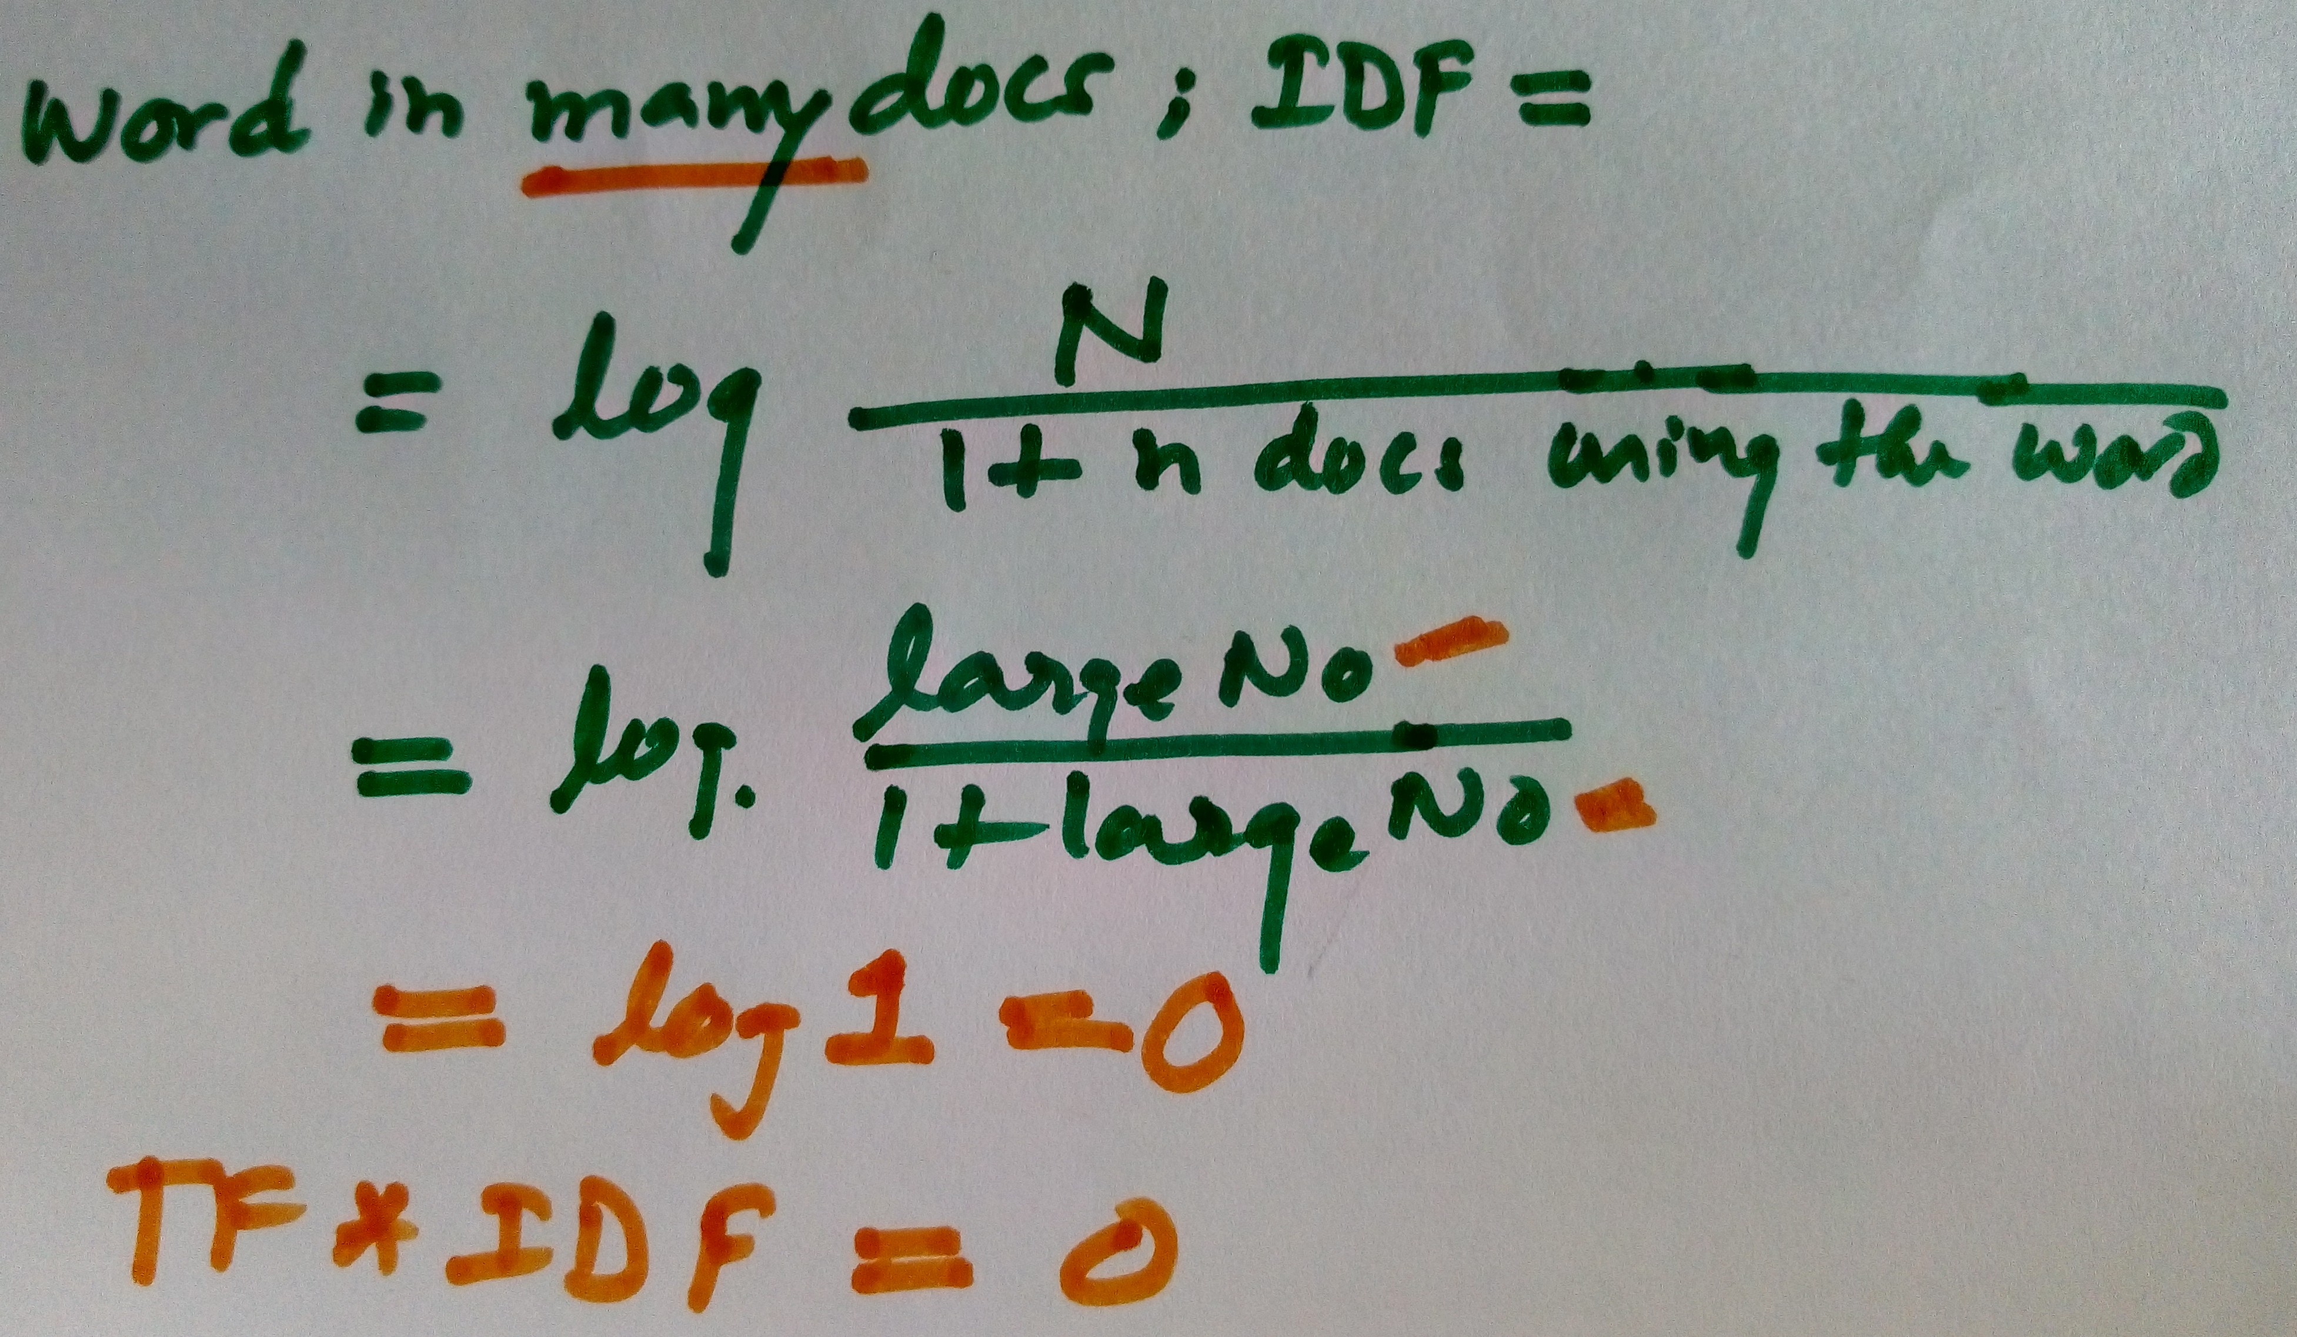
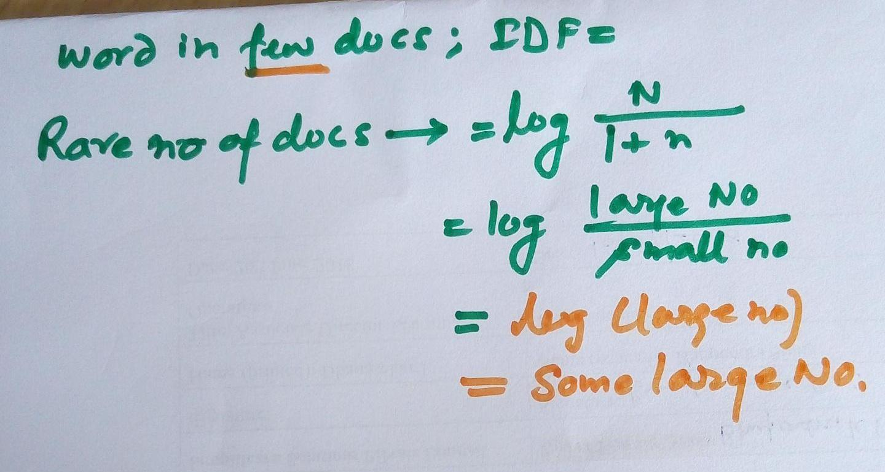
So how it down weighs?
IDF(t) = log_{e}(Total number of documents / Number of documents with term t in it).

Slide 12
How it works
Document 1: The game of life is a game of everlasting learning
Document 2: The unexamined life is not worth living
Document 3: Never stop learning
Search on these documents with the following query: life learning
Step 1: Term Frequency (TF)
TF for Document 1 | Number of words | the | game | of | life | is | a | everlasting | learning
Term Frequency | 10 | 0.1 | 0.1 | 0.1 | 0.1 | 0.1 | 0.1 | 0.1 | 0.1
TF for Document 2 | Number of words | the | unexamined | life | is | not | worth | living
Term Frequency | 7 | 0.14286 | 0.142857 | 0.14286 | 0.14286 | 0.14286 | 0.14286 | 0.142857
TF for Document 3 | Number of words | never | stop | learning
Term Frequency |  | 0.33333 | 0.333333 | 0.33333

Slide 13
How it works
Step 2: Inverse Document Frequency (IDF)
IDF(game) = log_{e}(Total Number Of Documents / (1+Number Of Documents with term game in it) )
IDF(game) = log_{e}(3 / 2) = 0.176091259
Similarly calculate IDF for all tokens.

Slide 14
How it works
Step 3: TF * IDF
Terms | IDF
the | 1.405507153
game | 2.098726209
of | 2.098726209
life | 1.405507153
is | 1.405507153
a | 2.098726209
everlasting | 2.098726209
learning | 1.405507153
unexamined | 2.098726209
not | 2.098726209
worth | 2.098726209
living | 2.098726209
never | 2.098726209
stop | 2.098726209
TF for Document 1 | the | game | of | life | is | a | everlasting | learning
Term Frequency | 0.01 | 0.02 | 0.02 | 0.01 | 0.01 | 0.01 | 0.01 | 0.01
TF for Document 2 | the | unexamined | life | is | not | worth | living
Term Frequency | 0.142857 | 0.142857 | 0.142857 | 0.142857 | 0.142857 | 0.142857 | 0.142857
TF for Document 3 | never | stop | learning
Term Frequency | 0.333333 | 0.333333 | 0.333333
 | Document1 | Document2 | Document3
life | 0.140550715 | 0.200786736 | 0
learning | 0.140550715 | 0 | 0.468502384

Slide 15
TfidfVectorizer and CountVectorizer
CountVectorizer just counts the word frequencies
With the TFIDFVectorizer the value increases proportionally to count but is offset by the frequency of the word in the corpus - This is the IDF (inverse document frequency part).

Slide 16
Limitations of Bag-of-Words
Vocabulary | requires careful design, most specifically in order to manage the size, which impacts the sparsity of the document representations.
Sparsity | Sparse representations are harder to model both for computational reasons (space and time complexity) and also for information reasons, where the challenge is for the models to harness so little information in such a large representational space.
Meaning | Discarding word order ignores the context, and in turn meaning of words in the document (semantics). Context and meaning can offer a lot to the model, that if modeled could tell the difference between the same words differently arranged (“this is interesting” vs “is this interesting”) (“old bike” vs “used bike)

Slide 17
scikit-learn - 3 ways to achieve this
Convert text to word count vectors with CountVectorizer.
Convert text to word frequency vectors with TfidfVectorizer.
Convert text to unique integers with HashingVectorizer.

Slide 18
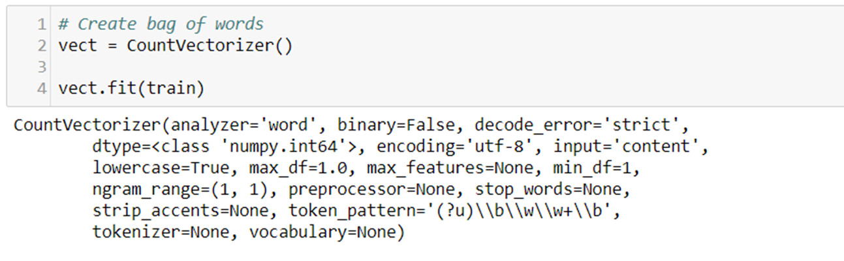
Tuning the vectorizer
stop_words : {‘English’}, list, None (default)

Slide 19
Tuning the vectorizer
ngram_range : tuple (min, max) such that min <= n <= max. default is (1, 1) .. E.g. ‘happy’, ‘not happy’
The document-term matrix will become large
unigram example |  |  |  |  |  |  |  |  |  | bigram
x1 | x2 | x3 | x4 | x5 | x6 | x7 | x8 | x9 | x10 | x1 x2 | X2 x3 | x3 x4 | x4 x5

Slide 20
Tuning the vectorizer
If the document frequency is too high, choose to ignore it
max_df : 0.5 (50%)
If less than 5% ignore it
min_df : 0.05 (5%)

Slide 21
Tuning the vectorizer
binary : boolean, default=False
If True, all non zero counts are set to 1. This is useful for discrete probabilistic models that model binary events rather than integer counts.

